Slide 1
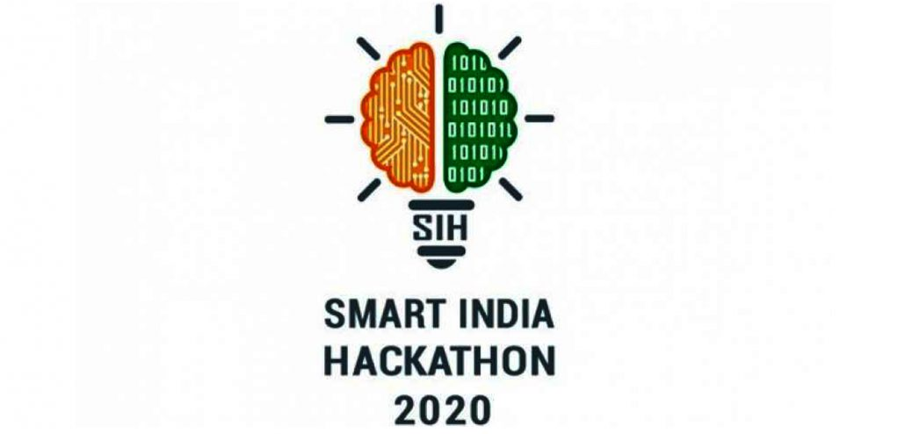
Smart India Hackathon 2020
Git Push Sleep Repeat

Slide 2
Project Details
Organization : NCR Corporation (India) Pvt. Ltd.
Problem Statement : Authenticating User while performing transaction at
ATM/POS Terminal Securely
Team Name : Git Push Sleep Repeat
Team Leader Name : Mrigank Singh
College Code : U-0497

Slide 3
Idea Description
Problem Statement
All aspects of security of ATMs has been of high concern since its invention. ATMs were used only for cash withdrawal, in their early life. However, as the function domain of ATMs has expanded, so has the threat to their integrity. Some Authentication Measures that are used today are PIN, biometric authentication which includes fingerprints, facial recognition etc. Unfortunately, none of these measures are 100% secure and breaches can happen in all of these. Therefore, a system has to be devised which helps the users to operate the ATM/POS terminals in a fully secure environment.
We have worked on a proposed idea for an Authentication Mechanism which is more secure than the already existing systems. This mechanism makes use of an under display camera touchpad screen. The user needs to enter his PIN through hand gestures symbolizing each digit. The system then applies Machine Learning Algorithms to identify the digits and hence complete the transaction.

Slide 4
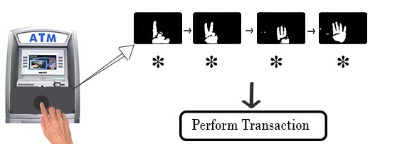
Solution

Slide 5
Technology Stack
Open Source Computer Vision (OpenCV)
-To Create Dataset for the problem
Deep Learning(Convolution Neural Network)
- To train the model for recognition
Django Framework
-To deploy this project through webapp
Frontend- React Js
Backend - Python

Slide 6
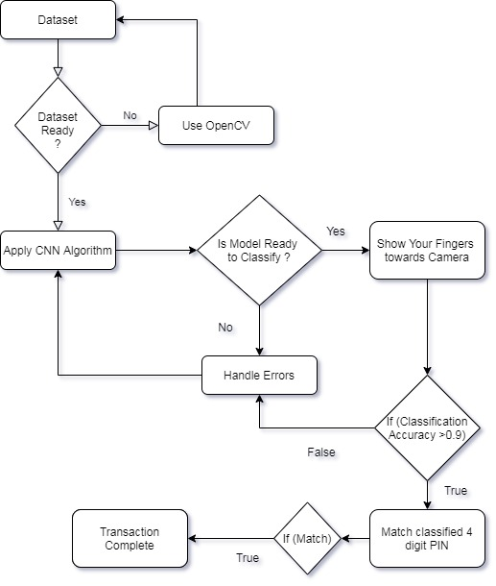
Flow Chart Of Solution

Slide 7
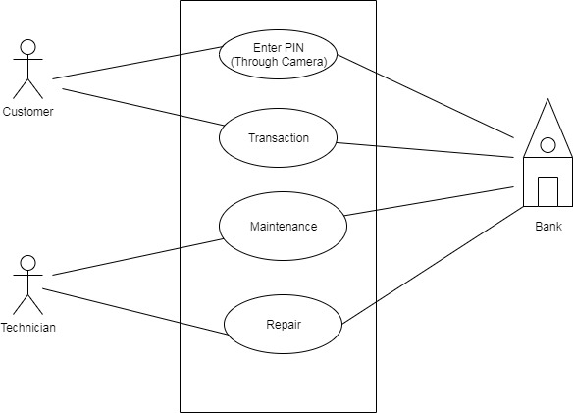
Use Case/Dependencies

Slide 8
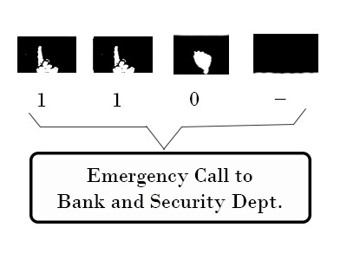
Uniqueness
Uniqueness-
The system provide a 3 digit emergency
Pin Facility for the users in case of emergency.
The use camera has an advantage that no one can see
the pin being entered in an ATM/POS Terminals.
The Fraud through ATM skimmers can also be avoided.

Slide 9
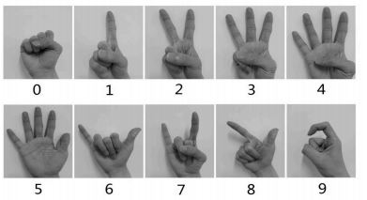
Guide to Gestures for Each Digit

Slide 10
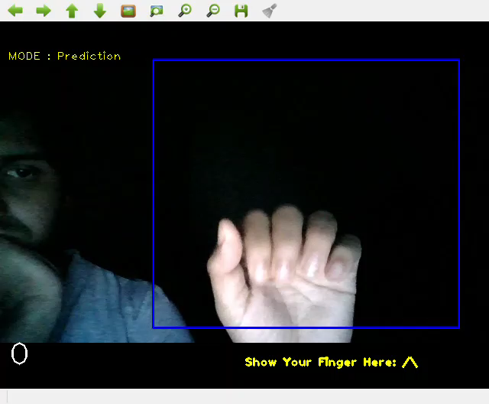
Prototype
This is our working Prototype

Slide 11


